Slide 1
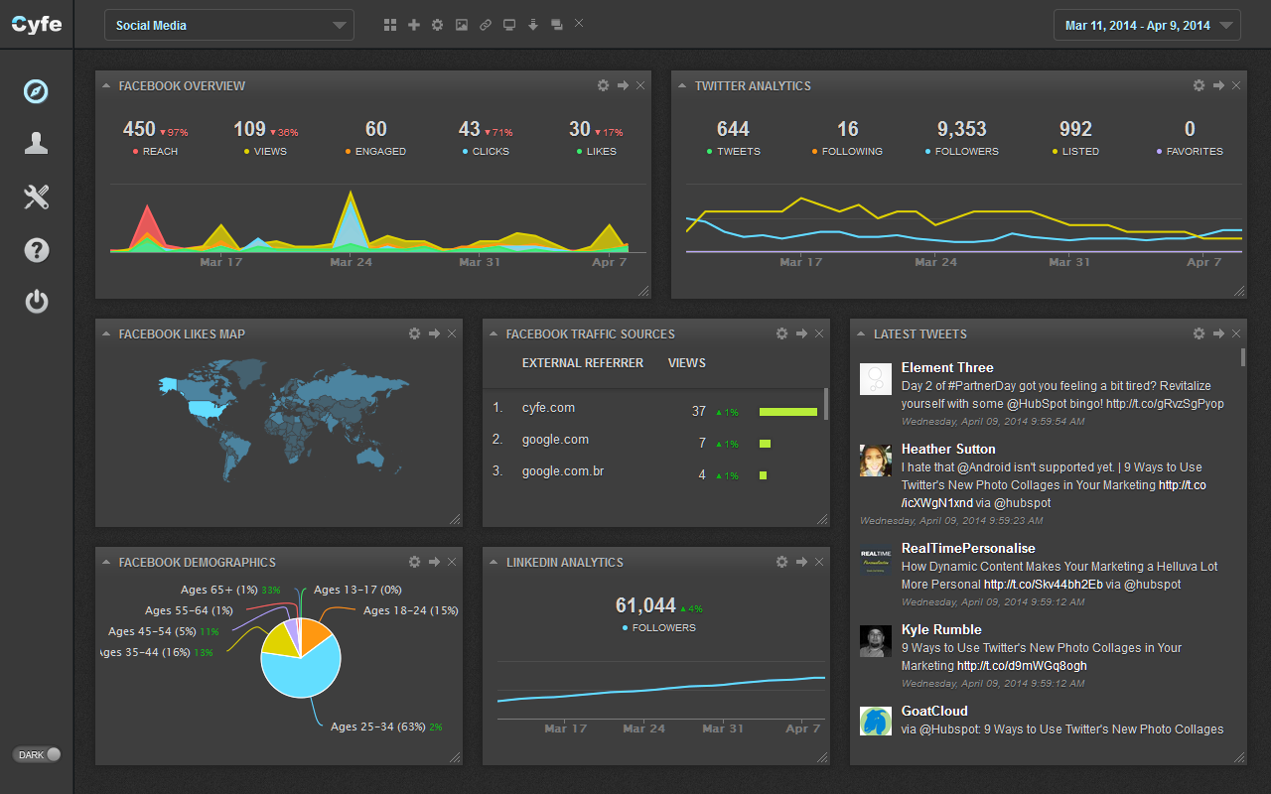
REMOTE MONITORING OF INDUCTION MOTOR
Done By,
J.U.PAVITHRAN,
M.P.SAKTHIVEL,
R.ARANGANATHAN
Guided By,
Prof.Kandasamy

Slide 2
INTRODUCTION
Nowadays with the emergence of Internet of Things(IOT),the Monitoring and controlling of machines have become much simpler and can be manipulated from any part of the world
The proposed idea will focus on monitoring of induction motor through a Web App powered by NodeJS as backend and using Arduino.

Slide 3
OBJECTIVE
Monitoring the induction motor remotely, facilitates the user to have full control over the application where the motor is put to use.
So ,the proposed idea will greatly help the Industrial Automation and Home automation applications which uses induction motor as the actuator.

Slide 4
METHODOLOGY
Embedded Hardware - Arduino UNO.
Actuator - Induction motor.
Middle-end - Nodejs webapp.
Frontend - Freeboard Dashboard.
Sensor - Temperature sensor,
Speed sensor,Current Sensor.

Slide 5
PROPOSED WORK
DECEMBER-18 Prototype of project.
January -6 review 2
January -22 Demo 1
FEBRUARY -9 Demo 2

Slide 6
PARAMETERS MEASURED
Temperature of motor.
Speed of motor.
Current through motor.
Acceleration of motor.

Slide 7
REFERENCES
http://www.intorobotics.com/build-robot-without-arduino-shield-r3-dc-stepper-motors-controlled
https://www.openhomeautomation.net/internet-of-things-dashboard/
https://www.arduino.cc

